Slide 1
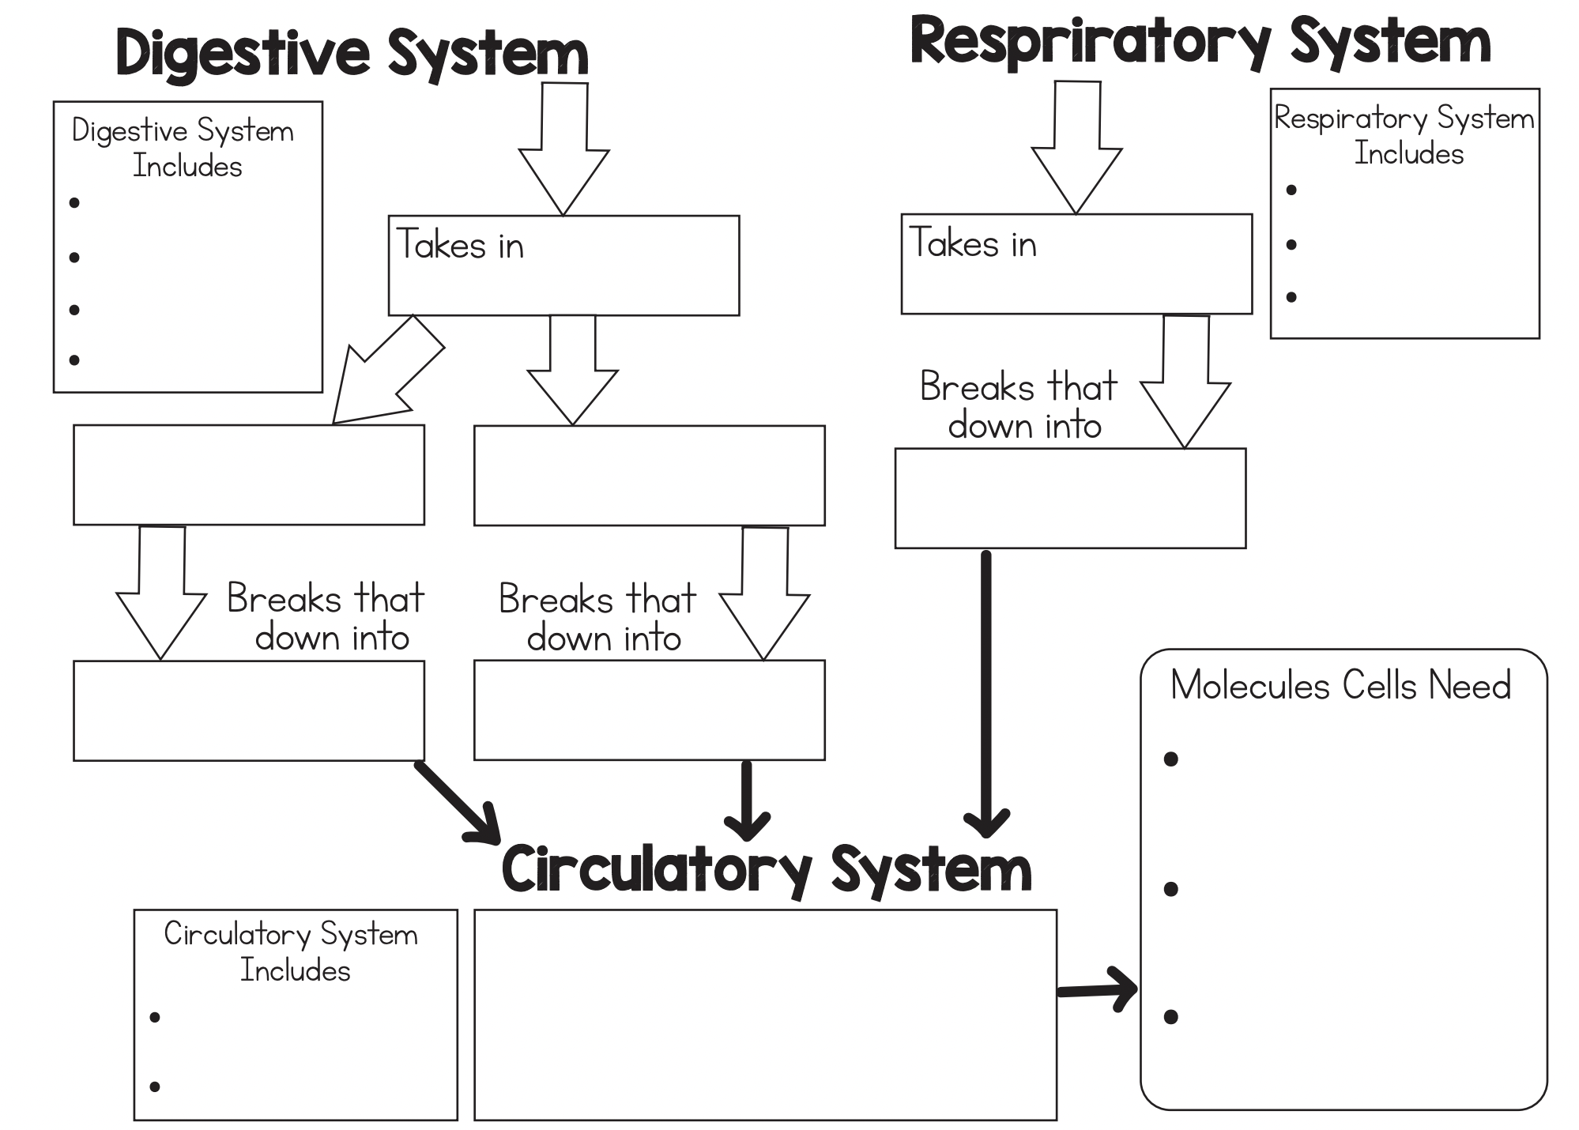
mouth
mouth
stomach
food
air
nose
small intestine
lungs
large intestine
starch
protein
oxygen
amino acids
glucose
glucose
amino acids
transports glucose, oxygen, and amino acid molecules to every cell in the body.
heart
oxygen
blood vessels

